Slide 1

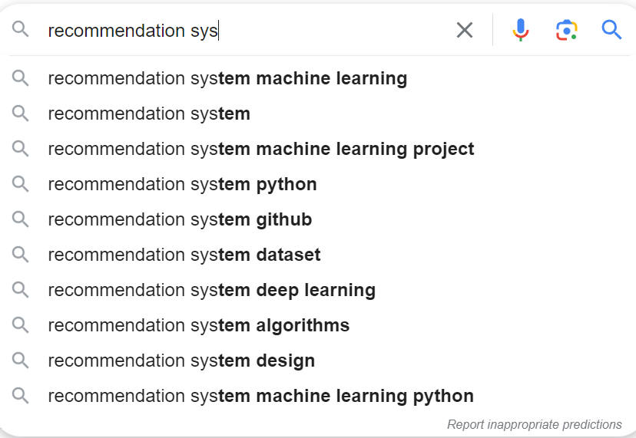
Recommendation systems

Slide 2
P-279 Book Recommendation ai variant
GROUP 4
-Avinash Vashisht

Slide 3
content
What is recommendation system ?
Applications?
Project Objective
Project Milestone
EDA
Data Cleaning
Modeling and Evaluation
Fetching Recommendations

Slide 4
What is a Recommender System ?
A recommender system is a system that is used to make prediction about the user preference
Recommender systems are trained to understand the preferences, previous decisions, and characteristics of people and products using data gathered about their interactions.

Slide 5

APPLICATIONS

Slide 6
APPLICATIONS
Movie recommendation in Netflix
Related products recommendation in Amazon
Web page ranking in Google
Friends recommendation in social networks eg. Facebook
News content recommendation in Yahoo News
Priorities Inbox and Spam mail filtering
Computational advertising in Yahoo
Online dating Sites

Slide 7
WHY?
To push content
More user engagement
To improve user ‘s experience
Providing user aid
Auto completion
Auto correction
Resource Friendly
Product Promotion

Slide 8
Business Objective
Generate the features from the dataset and use them to recommend the books accordingly to the users.

Slide 9
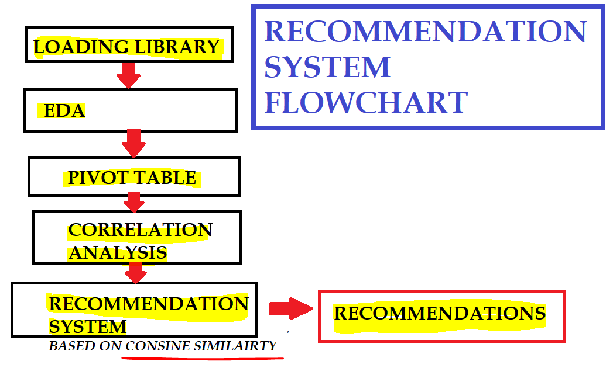

Slide 10
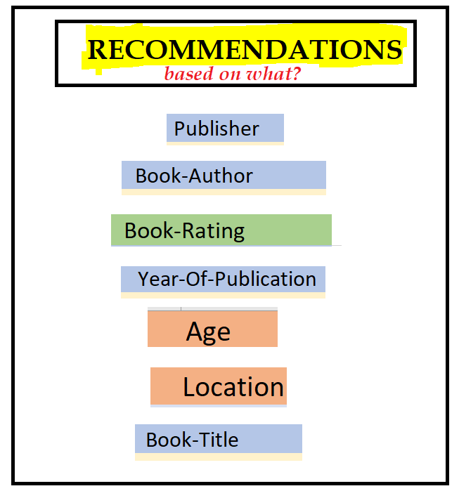

Slide 11


Slide 12
DATASET ANALYSIS
BOOKS DATASET | USER DATASET | RATINGS DATASET
●ISBN (unique for each book) ●Book-Title ●Book-Author ●Year-Of-Publication ●Publisher ●Image-URL-S ●Image-URL-M ●Image-URL-L ●Shape of Dataset - (271360, 8) | ●User-ID (unique for each user) ●Location (contains city, state and country separated by commas) ●Age Shape of Dataset - (278858, 3) | ●User-ID ●ISBN ●Book-Rating ●Shape of Dataset -(1149780, 3)

Slide 13
DATA CLEANING
BOOKS DATASET | USER DATASET | RATINGS DATASET
● only 3 missing values ● dropping | ● Age – 40% missing values ●Outliers in Age column ●Age has positive Skewness (right tail) so we can use median to fill Nan values | ●most of ratings filled with zero ●Book-Rating – 65% missing values

Slide 14
Data Cleaning cont..
Number of Unique Book Authors are 102023
Number of Unique Books are 242135
user unique geolocation : 57339
Age : so many missing values
measures taken for Age Attribute : Median

Slide 15
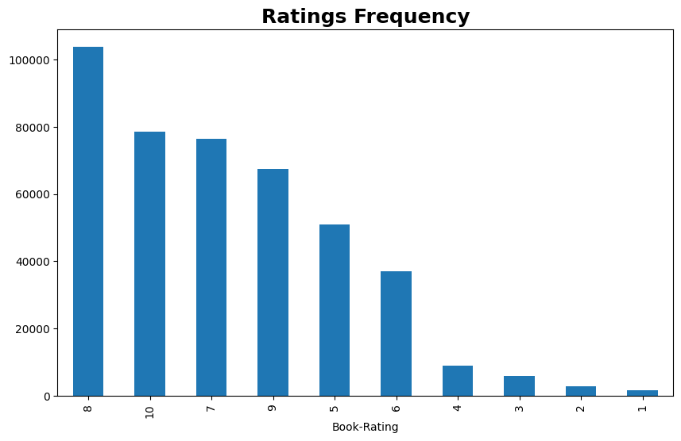
Observations from Ratings DATASET (Books Ratings)

Slide 16
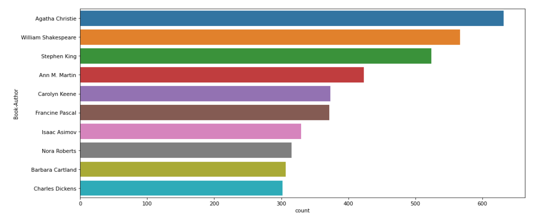
Observations from Book dataset (Authors)

Slide 17
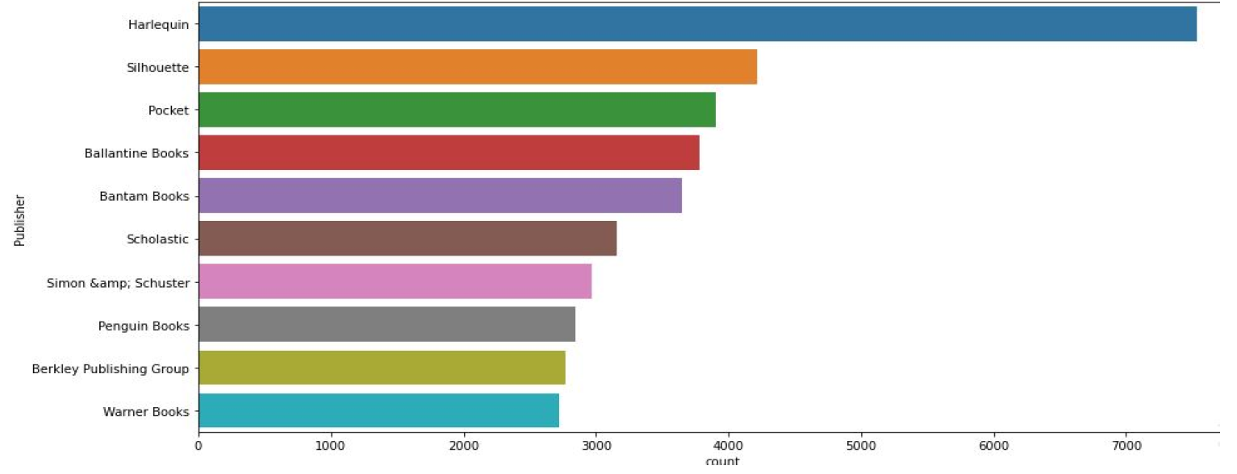
Observations from Book DATASET (Publishers)

Slide 18
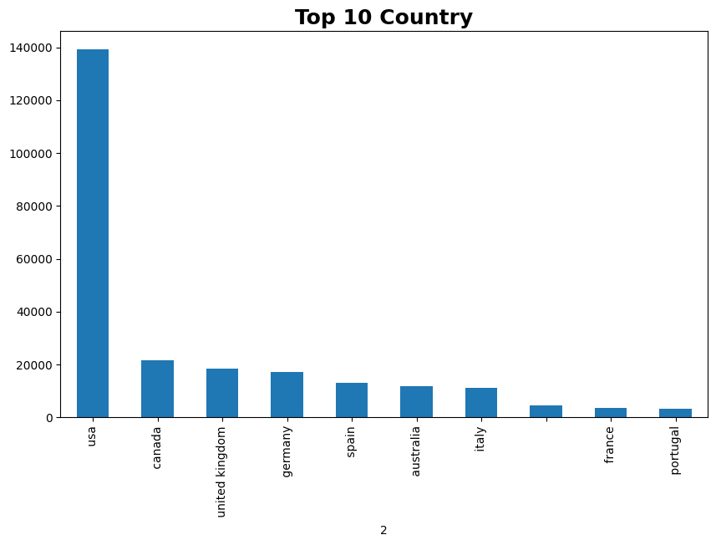

Slide 19
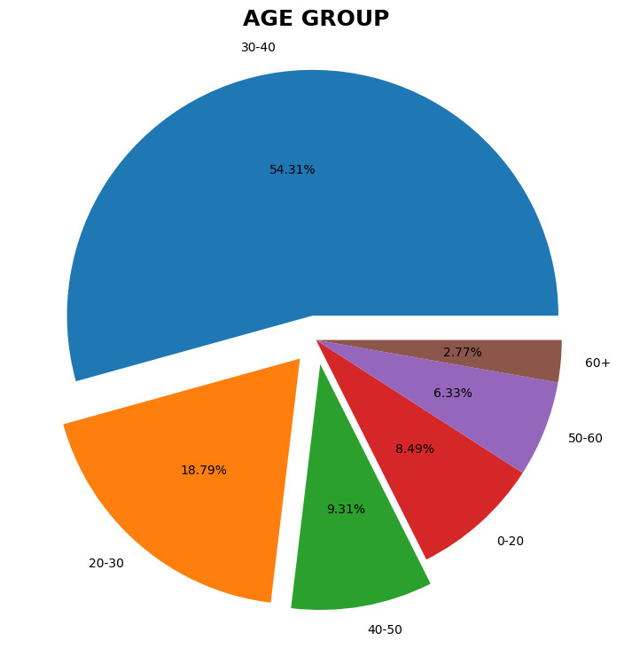
Most user of age group 30-40
More than 50 %
2nd major Gorup is 20-30
20-40 age group takes upto 70%

Slide 20
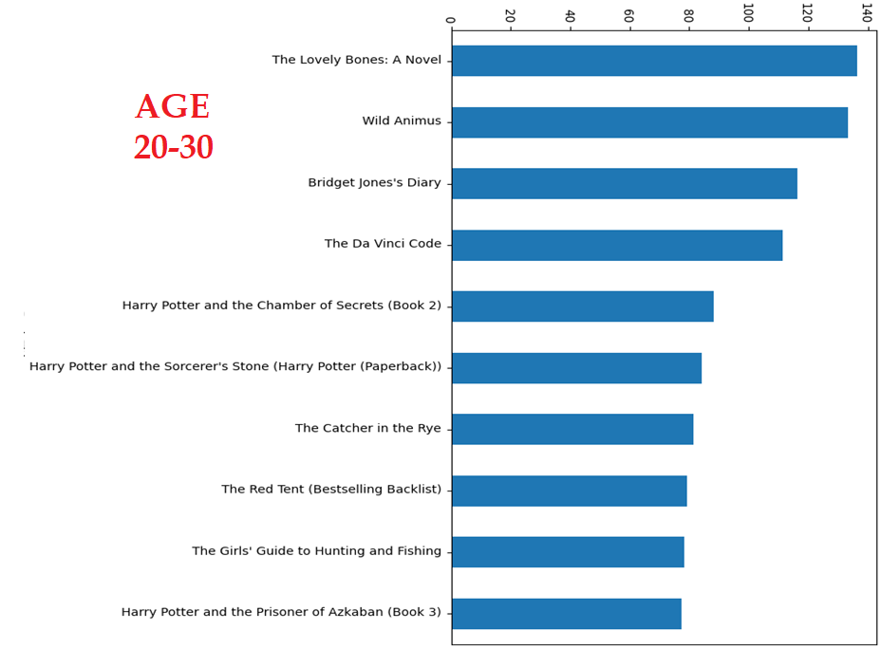

Slide 21
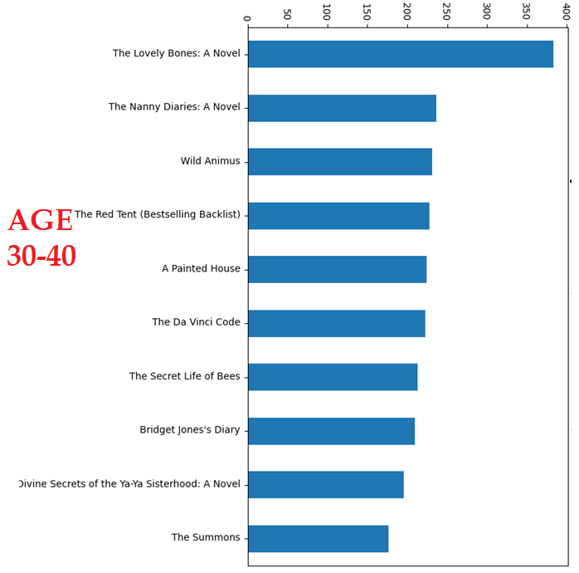

Slide 22

MEASURE FOR SPARSITY

Slide 23
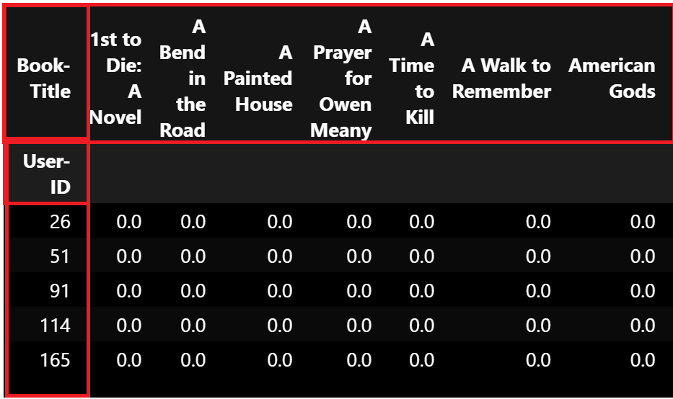
UTILITY MATRIX

Slide 24
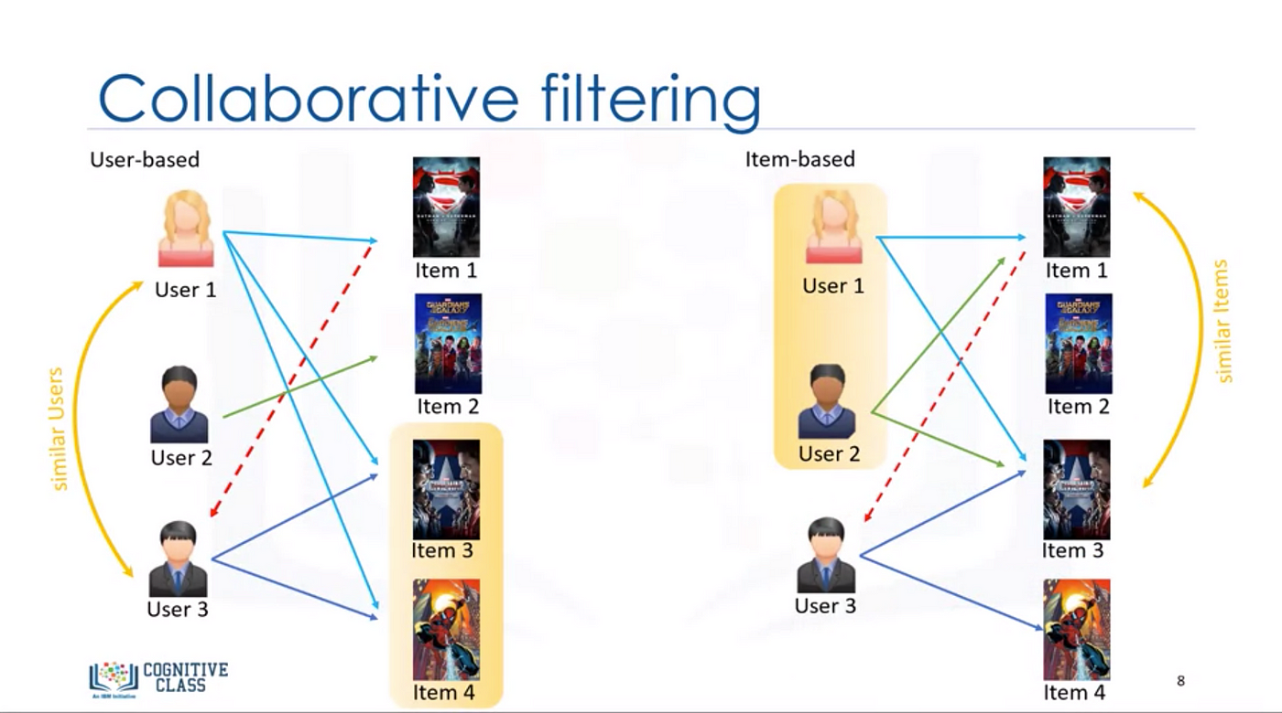

Slide 25
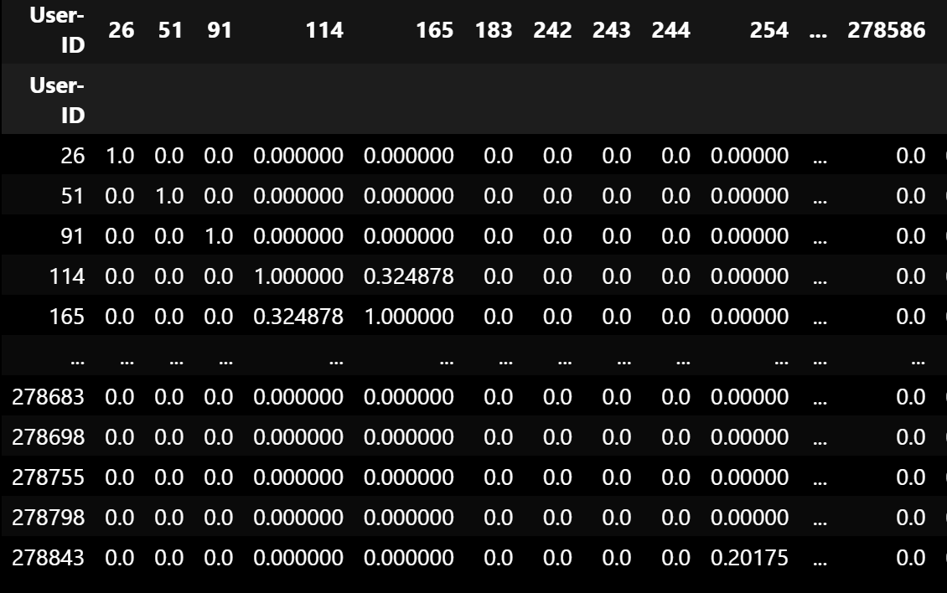
User-User-Based Collaborative Filtering

Slide 26
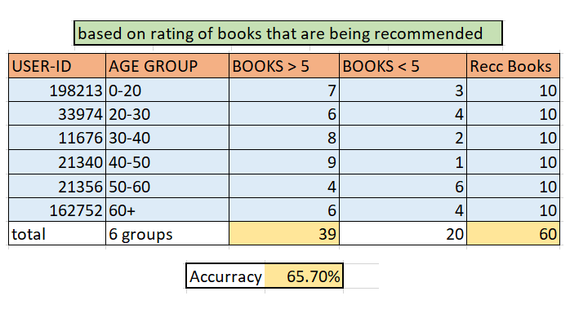
USER-USER EVALUATION

Slide 27
ITEM-ITEM-Based Collaborative Filtering

Slide 28
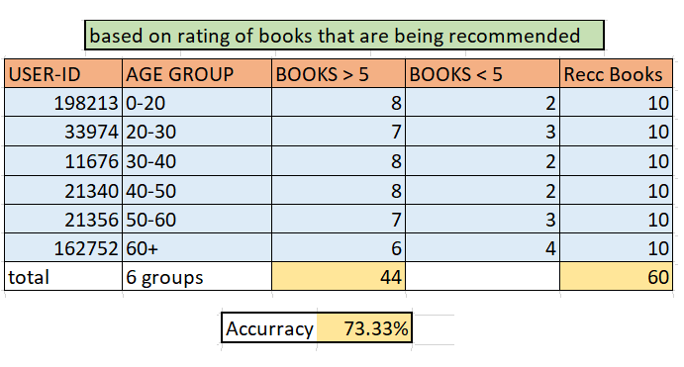
ITEM-ITEM EVALUATION

Slide 29


Slide 30
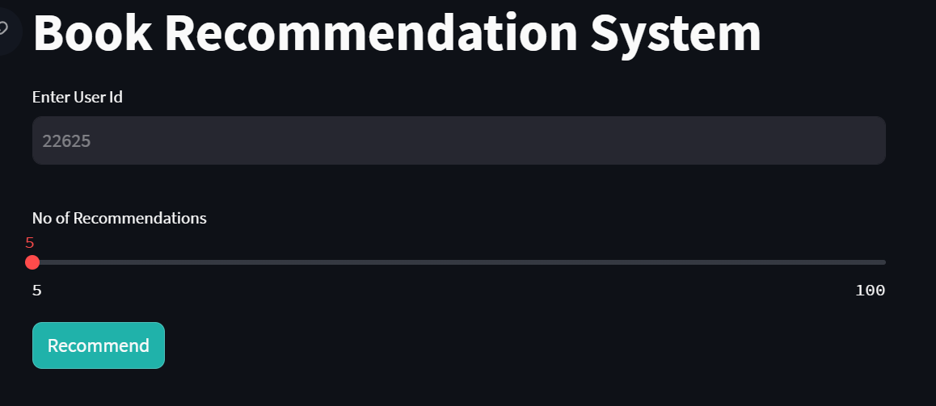
FETCHING RECOMMENDATIONS

Slide 31

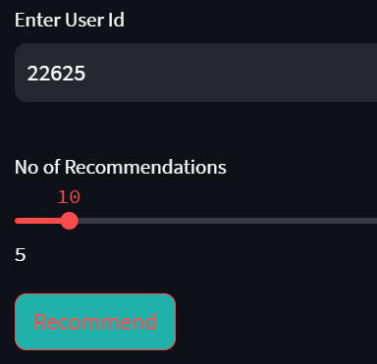

Slide 32
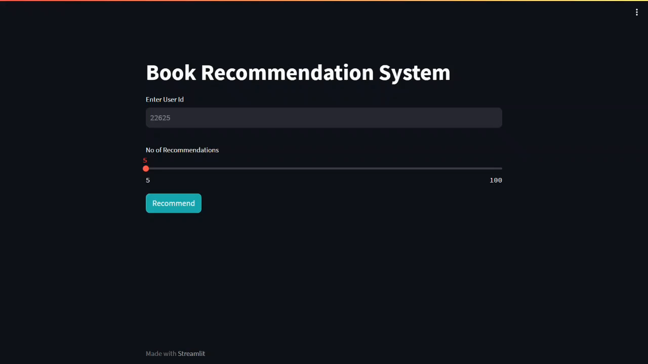
DEMo

Slide 33
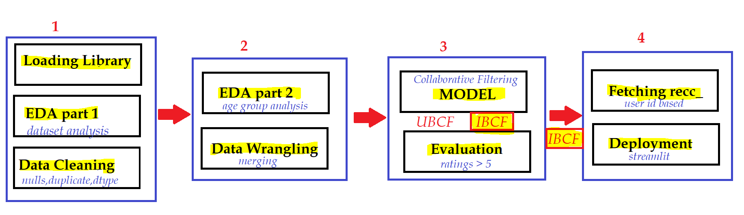
conclusion

Slide 34
Challenges
data cleaning was a major challenge in features like Location
missing value , outlier treatment was challenging as well
handling of sparsity was a major challenge
metric for evaluation

Slide 35
Future Scope
Given more information regarding the books dataset, namely features like Genre, Summary etc, we could implement a content filtering based recommendation
explore various clustering approaches wrt age groups and ratings
Predicting ratings

Slide 36


